Slide 1
PRELUDIUM 21
Call for proposals for research projects addressed at researchers who are not PhD holders and are at the beginning of their research career

Slide 2
PRELUDIUM – research projects for researchers who are not PhD holders https://www.ncn.gov.pl/en/ogloszenia/konkursy/preludium21
A person who is not a PhD holder on the proposal submission date may act as the principal investigator in a project submitted under the PRELUDIUM call for proposals.
One can act as a principal investigator only once.
The principal investigator must reside in Poland for at least 50% of the project duration period and be available to the host institution.

Slide 3
PRELUDIUM - research projects for researchers who are not PhD holders https://www.ncn.gov.pl/en/ogloszenia/konkursy/preludium21
The deadline for the submission of proposals in ZSUN/ OSF is 15 June 2022, 4 p.m.
The call results will be announced in December 2022.
Evaluated research results must be the effect of project implementation. The results must be published in an international academic journal.

Slide 4
BASIC REQUIREMENTS
Basic research proposals may be submitted to the call
The Principal investigator is not a PhD holder
Projects can be carried out for the period of 12, 24 or 36 months
Maximum available funds are:
70,000 PLN for projects lasting 12 months
140,000 PLN for projects lasting 24 months
210,000 PLN for projects lasting 36 months

Slide 5
BASIC REQUIREMENTS
The number of research team members must not exceed three.
The research team member who is the holder of a research title will act as mentor
The mentor must not be a beneficiary of funding granted for the project in any form whatsoever.
The costs of research equipment, devices and software to be purchased or constructed cannot exceed 30% of the funds applied for in the research project
The project budget must be planned for the entire period of project implementation, without division into years.

Slide 6
Basic research
Basic research is defined as empirical or theoretical endeavours undertaken to gain new knowledge of the foundations of phenomena and observable facts, without any direct commercial use.

Slide 7
Each researcher must have an ORCID – ID for researchers
ORCiD is a digital ID that distinguishes you from every other researcher in the electronic resources. It is designated to eliminate the problem od lapped names of authors, different written versions of authors’ names and also to specify the identity of the researcher.
At the moment ORCID is not obligatory.

Slide 8
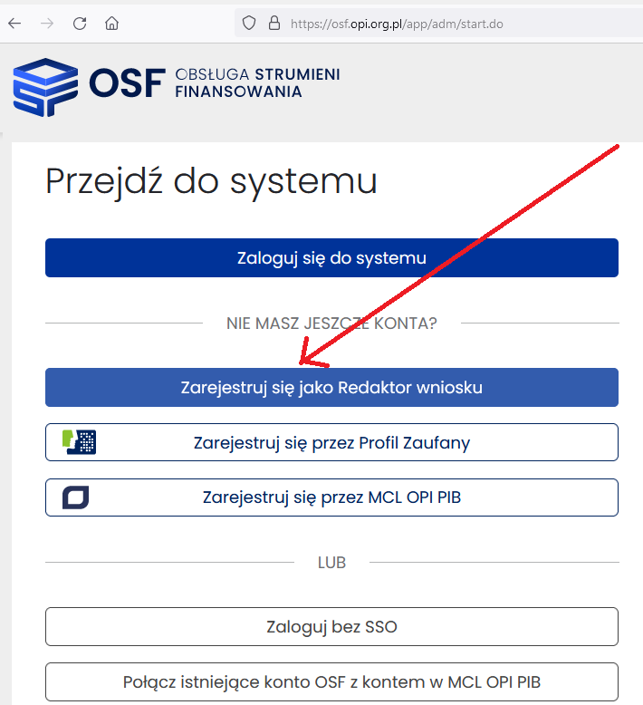
NCN research projects
Proposals must be submitted electronically via ZSUN/OSF, available at https://osf.opi.org.pl

Slide 9
Proposal submission procedure at Office of Research Administration(BOB) website: http://bob.uw.edu.pl/ncn-opus-23-preludium-21-otwarte-konkursy/

Slide 10
Data concerning the Applicant (that is the University of Warsaw) is available at: http://bob.uw.edu.pl/dane-do-wnioskow/

Slide 11
PRELUDIUM – team
Research team in PRELUDIUM projects may comprise of no more than three people:
principal investigator,
mentor,
optionally co-investigator who is at most a PhD holder.
The competencies and tasks of research team members must be described in the proposal. The reason of their involvement in the project are evaluated by the expert team.
Remuneration of up to PLN 1,500 per month for the research team, i.e. principal investigator and (optionally) co-investigator.
The mentor must not be a beneficiary of funding!

Slide 12
PRELUDIUM – budget
Detailed scope of eligible and non-eligible costs is defined by Annex 2 to NCN Council Resolution No 12/2021 of 5 March 2021 amending the Regulations on awarding funding for research tasks funded by the National Science Centre as regards research projects – Costs in research projects
Please read up-to-date documentation before fulling out the proposal – scope of eligible and non-eligible costs may be different in every Call for proposals!
Example: once it was allowed to organize a conference as part of the project – now it is a non-eligible

Slide 13
PRELUDIUM – budget
Indirect costs constitute up to 20% of direct costs, including research equipment, devices and software;
Additionally: indirect cost of Open Access (up to 2% of direct costs) may be designated only for the cost of open access to publications or research data.
At present, the policy does not cover the rules for publication of monographs, monograph chapters and peer-reviewed collected works (see: paragraph 2 in Annex no 1 to Order no 38/2020 of the Director of National Science Centre)
This means that publication of a monograph in open access can be planned as a direct cost – but PLEASE NOTE! In case of publication of monographs the costs can be incurred only after the proposal has been positively evaluated in the proposal evaluation procedure conducted by National Science Centre.
Direct costs x 20% = indirect costs
Direct costs x 2% = Open Access costs
Direct costs + Open Access costs + indirect costs = Total costs

Slide 14
PRELUDIUM – budget
Project budget consists of direct and indirect costs.
Direct costs include:
Remuneration for the research team that is for the project investigator and (optionally) co-investigator, amounting to up to 1,500 PLN per month – that is the amount for all investigators;
purchase or construction of research equipment, devices and software: their value cannot exceed 30% of the funds applied for in the research project; (PLEASE NOTE: pursuant to the accounting rules (policy) binding at the University of Warsaw, a PC, printer or scanner are considered to be fixed assets – Public Procurement Law is binding);
purchase of materials and small equipment;
outsourced services – that is services for which an invoice will be issued , e.g. proofreading, editorial, graphic and consulting services;
business trips, visits and consultations;
Other costs – crucial for the implementation of the project (e.g. purchase of data, special publications, research aids, costs of research results publication), comply with the Types of costs in research projects funded by the NCN. (PLEASE NOTE: In case of the publication of monographs the costs may be incurred only after the proposal has been positively evaluated in the proposal evaluation procedure conducted by National Science Centre.)

Slide 15
PRELUDIUM – non-eligible costs (examples)
Fees from natural persons in organisations, associations etc.,
Costs of procedures related to the award of an academic/research degree/title
Costs of organising conferences, workshops, seminars, meetings
Costs of salaries for the administrative personnel
renovations
For more details please refer to Annex no 2 of the Regulations, p. 57

Slide 16
PRELUDIUM – additional documents
Declaration of the PI’s mentor that he/she has read the research project description and supervises the project
Upload the document signed by hand and scanned OR signed with an electronic signature* in the PAdES format.
Specimen document available in the OSF system and call announcement: https://ncn.gov.pl/ogloszenia/konkursy/preludium21

Slide 17
PRELUDIUM – International Cooperation section (optional)
International cooperation means that research tasks are carried out together with investigators from foreign entities. It is necessary to name a specific hosting institution in the research proposal.
The following are not considered international cooperation:
participation in international conferences;
dissemination of information on the project abroad;
implementation of research tasks by a Polish research team abroad without the participation of investigators from foreign entities;
cooperation with foreign researchers employed by Polish entities.

Slide 18
NCN Calls for proposals: How to prepare your proposal
Read all the documents available for the open call for proposals
Make sure all costs are well justified
make sure that all tabs have been completed in the correct language
Upload correct Attachments in correct places (pay attention to the number of attached publications!)
Submit the proposal on time in the OSF system
Check completeness before submitting!

Slide 19
Crucial elements of the proposal
Title – clear and transparent,
It will be important on the second stage of evaluation (for reviewers), should be transparent and contain information facilitating the identification of research objectives.
Make sure to avoid informal language, jokes and rhetorical questions
Please note: about 92% of reviewers on the second stage of evaluation are foreign reviewers.

Slide 20
Crucial elements of the proposal
Descriptors (panels) – describe the subject matter of the proposal →influence the selection of reviewers and their first impression
Np.: HS – Arts, Humanities and Social Sciences
HS1 Fundamental questions of human existence and the nature of reality - philosophy, cognition, religious studies, theology
HS1_001 History of philosophy (acient, medieval, modern and contemporary) and history of ideas
HS1_002 Ontology and metaphysics, particular ontologies
HS1_003 Epistemology (incl. sources of knowledge, criteria of truth, philosophy of language)
HS1_004 Logic, science methodology, philosophy of science
HS1_005 Philosophy of human, theories of personality, philosophy of culture, social philosophy
HS1_006 Nature of human mind (incl. mind’s evolution, bio-psychological conditions of cognition, artificial intelligence) etc.

Slide 21
Key words – there are no limitations concerning key words; they are supposed to facilitate the selection of suitable reviewers; constitute the extension of the title
Abstract (EN) – invitation to review, consists of three sections:
underlining of the scientific goal of the project
methodology
influence on the discipline
up to 4500 characters with spaces

Slide 22
Short description (EN) – 1st stage of merit-based evaluation max 5 pages
submitted for evaluation to researchers who deal with related fields of knowledge
Only the most important information – clear description of what you would like to do. It is recommended to write a few words about the way in which research results will be disseminated, in particular on the international scale. This is a text for researchers from our field, it will facilitate the assignment of the proposal to a suitable group pf experts.
bibliography!

Slide 23
Detailed description (EN) – II stage of merit-based evaluation max 15 pages
submitted for evaluation to experts from a given discipline
should include details concerning the planned research tasks, that is the description of the scientific goal of the project, influence on science and the planned research methodology
Bibliography! – it is recommended to include the list of literature (local and international)

Slide 24
Abstract for the general public (PL & EN) – understandable for everyone, not so much merit-based as the Abstract – comprehensible for a layperson. Should the project qualify for funding, the abstract for the general public will be published on the National Science Centre’s website.
Publication Record – publications with an international reach are preferred Up to 10 most important papers published or accepted for publication over the period of 10 years prior to the proposal submission year. The period of 10 years shall be extended by any career breaks specified in the form.
Please Note: it is recommended that the PI has his/her own ORCID ID.
Should I mention the papers connected with the project’s subject matter or the most important ones? – it is hard to say, surely the papers with an international reach are preferred

Slide 25
Research tasks - the list of tasks planned for implementation. It is a merit-based plan, it should be treated as merit-based table of contents.
It is prepared in two language versions: Polish and English
What is not considered a research task:
Project management – it takes place in every project, naturally!
the purchase of research equipment, management of the equipment
Participation in conferences
Preparation of publications, final report
Translations

Slide 27
Other important information
Research hypothesis is very important – every successful proposal has a hypothesis!
It is not necessary to include a detailed research schedule, but a general schedule helps to evaluate the project. It has to be merit-based!
It is good to show the results of preliminary research (if you have them)
Risk analysis is an important part of every project and is also evaluated (you have to plan a strategy (reaction) in response to a risk, preferably give alternatives enabling the implementation of research tasks if any task involves some kind of a risk)

Slide 28
Possible risks
What if the Archive is closed?
The area is suddenly included in a war zone?
Archaeological station is flooded?
The legal regulations change?
I will not be invited to be a member of the research team e.g. refugee camps?
What if I will not find the planned number of respondents for my research?

Slide 29
NCN recommendations
NCN pays a special attention to the quality of data included in the proposal.
It is recommended to:
Carefully consider the composition of the research team so that it will represent all the required competences
Well justify the costs of the project
Do not omit any tabs and do not complete them in Polish if English is required
Check the proposal before submitting it to NCN (it happens that a working version of an attachment is uploaded, the proposal includes comments such as ‚to be completed’ etc.

Slide 30
Principal investigator – tabs in the electronic system that raise doubts
The most important achievement of the PI:
It could be the research plan that resulted in writing an interesting paper
Projects tab in the PI’ academic and research track record:
You should mention only your own projects, those where you were PI or you managed a major task.
Do not mention other people’s projects → otherwise your proposal will be disqualified from evaluation.
Do not mention projects where you acted as an investigator. Those projects can be mentioned in the section „Academic and research career”, where you indicate your function in the project.

Slide 31
Other tabs that generate questions
Data management plan – general information and definitions as well as an exemplary plan can be found on the Office of Research Administration (BOB) website: http://bob.uw.edu.pl/plan-zarzadzania-danymi-ogolne-informacje-o-pojeciach-oraz-przykladowy-plan/

Slide 32
PRELUDIUM – evaluation criteria
A. PROJECT ASSESSMENT (80%)
A1. SCIENTIFIC QUALITY OF THE RESEARCH PROJECT (50%)
scientific relevance, importance, originality and novelty of research or tasks to be performed; quality ought to be evaluated in an international context
A2. POTENTIAL IMPACT OF THE RESEARCH PROJECT (15%)
the potential for substantial international impact on the research field(s) and for high quality research publications and other research outputs, taking into account the specifics of the research field and the variety of forms of impact and output; impact ought to be evaluated using an international context

Slide 33
PRELUDIUM – evaluation criteria
A3. FEASIBILITY OF THE RESEARCH PROJECT (15%)
the feasibility of the proposed project, including the appropriateness of the research methodology to achieve the goals of the project, the risk management description, the principal investigator's qualifications, the structure of the research team, research facilities and equipment, international cooperation (if any), other factors affecting the feasibility of the project

Slide 34
PRELUDIUM – evaluation criteria
B. QUALIFICATIONS AND ACHIEVEMENTS OF THE TEAM MEMBERS (20%)
the scientific achievements of the principal investigator and mentor in the past 10 years
B1. QUALIFICATIONS AND ACHIEVEMENTS OF THE PRINCIPAL INVESTIGATOR (10%)
B2. QUALIFICATIONS AND ACHIEVEMENTS OF THE MENTOR (10%)

Slide 35
The Reviewers pay special attention to:
Short description
Incorrectly assigned to a panel
The project is not feasible during the period defined in the proposal
The academic and research career track is not compatible with the project’s subject matter
Detailed description
Usefulness of project’s research results
Overview of basic literature
Originality of the project
Lack of detailed research questions
Goals
Too general

Slide 36
The Reviewers pay special attention to:
Budget
Amount of requested funding
Are the costs specific enough and transparent
Justification of costs in relation to the proposed research tasks
Conference costs (they are often considered too high)
Remuneration

Slide 37
Contact
Address: University of Warsaw – Office of Research Administration
(Biuro Obsługi Badań) Krakowskie Przedmieście 26/28.
00-927 Warszawa Audytorium Maximum, 1st floor
http://bob.uw.edu.pl/kontakt/

Slide 38
Thank you for your attention. Good luck!

